Slide 1
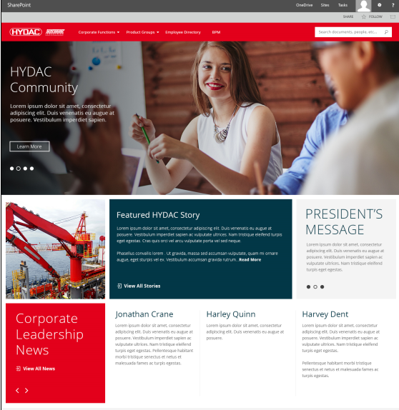
HYDAC – SharePoint Intranet
Business Need
HYDAC provides fluid power solutions, industrial products and heavy duty mobile equipment. The company is headquartered Pennsylvania with 50 subsidiaries and remote offices across the US. HYDAC was company that had remote offices all across the US. They wanted us to help with giving departments/locations their own place to manage their work, collaboration sites, and share big impactful news company wide if needed. They also needed a redesign of their extranet.
Project Scope
Affirma redesigned and implemented HYDAC's internal intranet to optimize the speed and navigational structure of their site. We also delivered their external facing Distributor's extranet portal. The subsidiaries were able to have their own space to collaborate more effectively amongst themselves. HYDA was so emphatically satisfied, we have been referred to two of their sister companies and have helped roadmap out their long-term SharePoint initiatives for migrations, UX Design, and external portals. This long-term strategic relationship encompasses road mapping, creative design work, and systems integration.

Slide 2
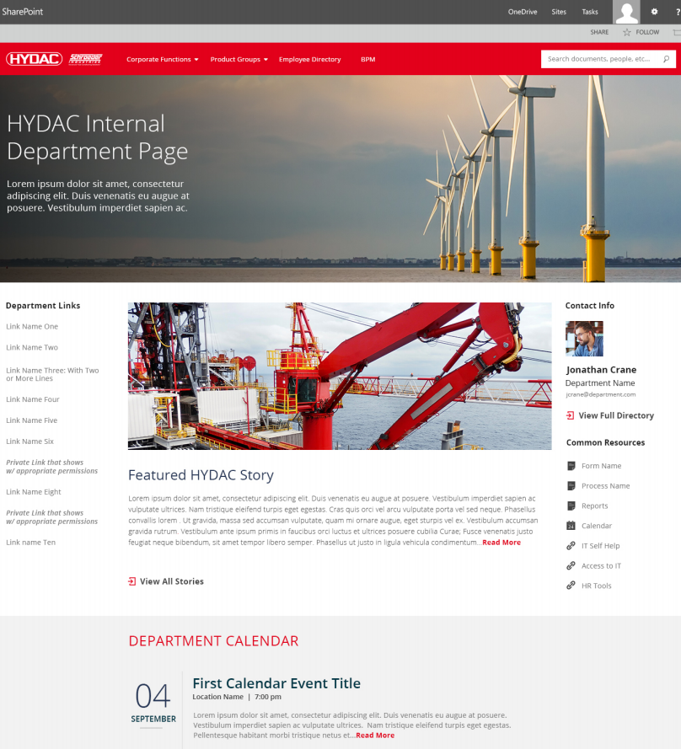
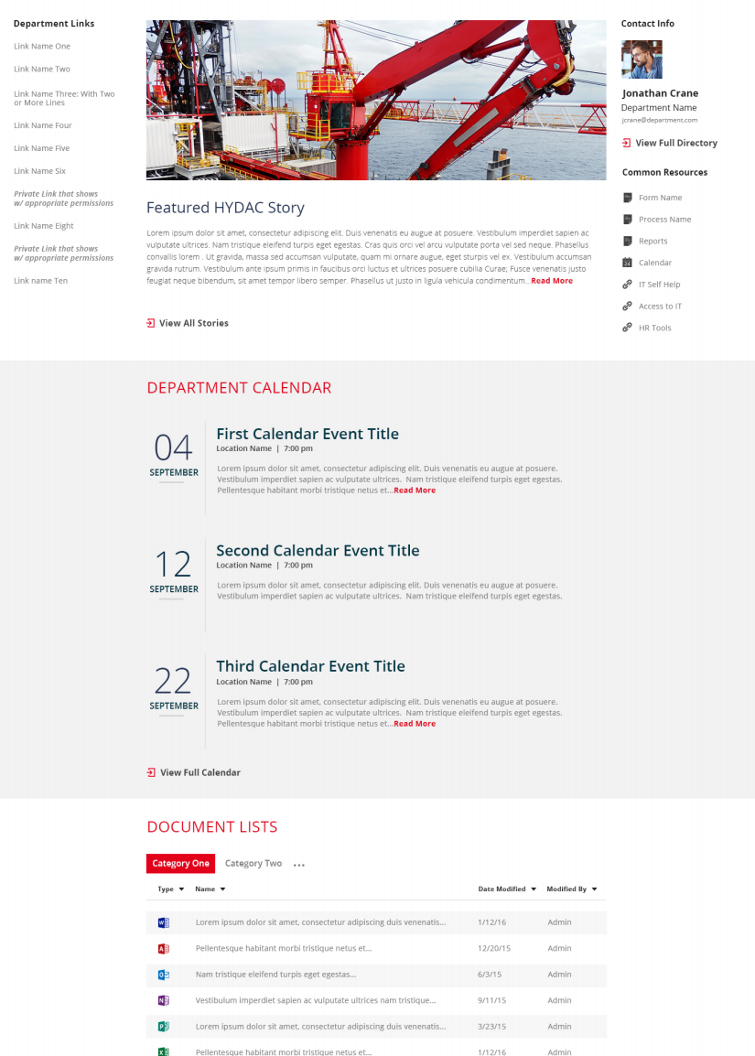
HYDAC - Intranet

Slide 3
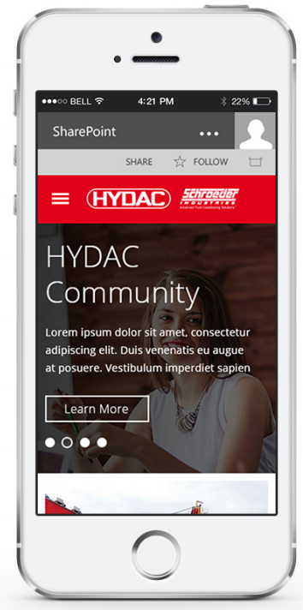
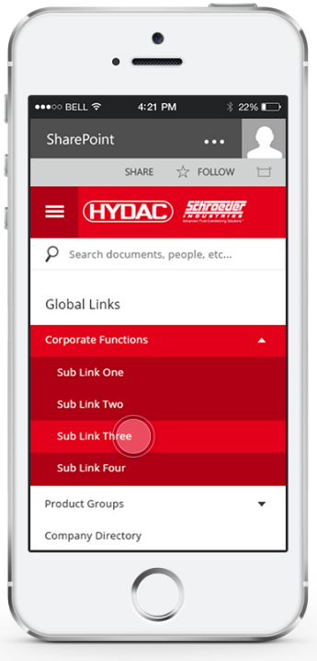
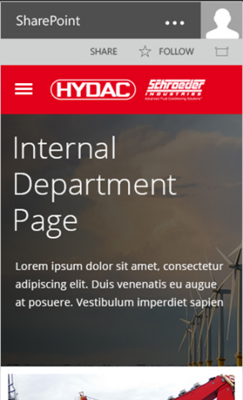
HYDAC – Intranet Responsive Design

